Slide 1
EE 295
TechWriting-Engineering Ethics
Oct 24, 2019
Room 339
Tom Wrappe
EE Lecturer

Slide 2
-Final Paper
-Outline/Abstract
-Resume Lecture
-No draft due
-Resume Research Practice Examples
+Skills
+Experience
+Uniqueness
-Ethics of the Product (Ch 8 Moriarity)
+Material Ethics
+Focal Product

Slide 3
Fair Warning
In Class Writing Exercise starting at beginning or end of class coming within next two weeks (be on time)
Allowed 25 minutes to complete (hard stop)
Topic will be per recent class lectures and discussions
Up to 10 points with 0 for “no show”
No makeups per syllabus
Attend your own section unless cleared at least 24 hour ahead in writing (deduct otherwise)

Slide 4
Semester Major Items…..(subject to modification)
 | Mid Term | Resume | Final Paper | Final Presentation (slides )
Topic Paragraph | 9.5.19
Topic Proposed | 9.12.19 |  | 10.3.19
Topic Final | 9.19.19 |  | 10.10.19
Outline/ Abstract | 9.26.19 |  | 10.31.19
Research | 10.1.19 | 10.24.19 (Class) | 10.15.19
Draft Complete | 10.13.19 ** |  | 11.7.19 | 11.19.19
Final Submit | 10.25.19 ** | 11.14.19 | 11.26.19 | 12.3.19
Final Presentation | NA | NA | NA | 12.17.19 (Sect 1) 12.12.19 (Sect 2)

Slide 5
Midterm Paper Checklist (1)
General
Clear title and “numbered” Subsections per the outline
Sources in “ A. Reference Sources”
Proper [xx] citations in the text
Topic Sentences underlined in each paragraph with mostly first sentence in para
Title and Abstract
Descriptive title with correct capitalization. Concise: not too long
Section Title: “1.0 Abstract”
Confirm that [a] Motivation thru [e] Keywords are present
Is the Motivation statement good or maybe needs to be “punched up”
Does [a] Motivation match with [d] Conclusions?
Does [b] Problem statement match with [c] Solution Statement?
“2.0 Executive Summary”
Are [f] through [I] present?
Is [g] problem statement clear?
Is [h] a clear financial statement of value?
Is [i] a clear recommendation?

Slide 6
Midterm Paper Checklist (2)
4. “3.0 Product Description” (Do not use Proposal)
a. Is [j] a clear product description (not a vague technical collection of buzzwords)?
b. Is [k] a clear statement of what makes the product special/differentiated?
5. “8.0 Conclusions and Recommendations”
a. Is there a clear “call to action” to the boss to support this product proposal?
6. “A. Reference Sources”
a. Complete IEEE format for all sources identified in [xx}]

Slide 7
Midterm Paper Checklist (3)
It | Description
1 | Personal Pronouns (I, we, our , us) | Verify by search
2 | No use of “very” | Verify by search
3 | Passives | Search on “is, will be, has been, etc” followed by a verb form (eg. “is developed”). Change to active
4 | Proper Paragraph Structure | Single topic sentence Do all other sentences support the topic sentence? If not, change
5 | Proper Flow | Underline topic sentences Do topic sentences of the paper flow per the outline (Sect 1-8)?

Slide 8
Final Paper Options

Slide 9
Expanding the Product Proposal for a Final Paper
Outline | Outline/ Abstract | Draft (5 pages) | Midterm paper (5 pages) | Final Paper ? 15 pages
1. Abstract | Paragraph | ½ page max | ½ page max | 1. Abstract
2. Executive Summary | paragraph | ½ to 1 page | ½ to 1 page | 2.Executive Summary
3. Product Description | 2 paragraphs or so | 1-3 pages |  | 3.0 Product Description (ex.) 3.1 System Description (ex) 3.2 Key technologies 3.3 Functional Description (ex.)
4 Mkt Research and Analysis | 1-2 paragraphs (5 sources min) | 1-3 pages | Depends on sources | 4.0 Mkt Rsch 4.1 Market 4.2 Competitors 4.3 Differentiators
5. Finance and Economics | Short paragraph | ½ to 1 page
6. Management Team | Short paragraph | ½ page
7. Risks and Assumptions | Short paragraph | ½ page
8. Conclusions and Recommendations | Short paragraph | ¼ to ½ page |  | 8. Concl/ Rec’s 8.1 Useful features 8.2 Recommended action
A. Sources | Not Applicable | ½ to 1 page | ½ to 1 page

Slide 10
Framework for Research Option #2
Area of Research
The “container” is the Analysis Process you choose:
-Compare multiple technologies by measuring their performance in a consistent “test” process (Comparative Analysis)
-Measure a single technology’s ability to perform a previously unachievable “test” (Feasibility Study)
Specific Topic
(Describe Specific Research
Research is a fluid.
It has the form of the container you choose.
Criteria for Analysis
ANALYSIS
Results and Implications
Conclusions &Recommendations

Slide 11
Final Paper: Outline/Abstract due Oct 31
Submit an outline and an abstract For your final Paper using 1-2 pages
Expand on your topic selection
-”Fine tune” your topic
-Create outline based on the complete Product Proposal or Research Paper outline
-Prepare a summary with one or two paragraphs (not bullet items, full sentence-based paragraphs) that capture the key elements of each section
Summarize your market and technology research (previously 20 sources)
-Fill out a complete checklist per instructions as a condition of grading
3.Provide a “budget” totaling 7200 +/- words (15 pages) for your Final Paper (Extended Proposal) or 5600-6000 words (10 pager Research)
4.Be ready to discuss during Nov 5 and/or Nov 7 class
5. Checklist and Peer Review (2) within one week of deadline
6.As always, 15% plagiarism or less is required from Turnitin

Slide 12
Resume Lecture

Slide 13
Start the Resume Research
-Posted on Canvas
-Final Due Nov 14, 2019
-BRING AT LEAST ONE JOB POSTING TO CLASS TU, Oct 29 and/or TH, Oct 31
-Find three (3) job postings. Analyze them, and determine what will influence the company to select you for consideration.
Write an analysis paragraph for each indicating how you think they will make the decision, what you have to offer, what you hope to get, and what the company will offer, and what they hope to get.
Indicate what you will place in the resume to influence the decision maker. Look beyond just the technical.
Write a targeted resume for each company.
Submit analysis and resumes on Canvas. The analysis must be plagiarism checked. Please put analysis and resumes in separate files. The resumes will be checked, but not scored.

Slide 14
Resume OOC Exercise
Analyze the job description and determine what will influence the company to select you for consideration
Write an analysis of each job indicating how you think the company will make the decision to interview and hire
what you have to offer, and what you hope to get
what the company will offer, and what they hope to get.
Indicate what you will place in the resume to influence the decision maker.
Look beyond just the technical

Slide 15
Resume Instructions: Canvas
-Find three (3) job postings. Analyze them, and determine what will influence the company to select you for consideration.
1.Write an analysis paragraph for each indicating how you think they will make the decision, what you have to offer, what you hope to get, and what the company will offer, and what they hope to get.
2.Indicate what you will place in the resume to influence the decision maker. Look beyond just the technical.
3.Write a targeted resume for each company.
Submit analysis and resumes on Canvas. The analysis will be plagiarism checked. Please put analysis and resumes in separate files. The resumes will be checked, but not scored.

Slide 16
The OOC Work Product
Provide a summary of the analysis you are going to perform and the elements that you are going to provide for each of the three job descriptions
Answer all the questions that are laid out in the assignment in a consistent, readable way
Finish up with a short conclusion on each analysis
Attach the resumes as a followon to the analysis
High Level Outline for OOC Assignment
Summary of assignment and your approach to analysis
Analysis #1
Analysis #2
Analysis #3
Resume #1, 2, 3

Slide 17
Resume Analysis
Job Descript | How you think the company will make the decision | What you have to offer | What the company will offer | What company hopes to get | What you will place in resume to influence (“wild card”)
#1:
#2:
#3:

Slide 18
Resume Deliverable Package
Canvas has complete description
Expectation is that there will be 4 or 5 paragraphs (Still avoid personal pronouns by using “based on analysis, the company likely expects…)
1. Introduction
Summary of the assignment and how you will approach the analysis of each Job description
2. Analysis of Job Description #1
-What is the Job?
-What is your analysis of the job description?
-What will you place in the resume to influence the particular opportunity?
3. Analysis of Job Description #2
4. Analysis of Job Description #3
5. Conclusion paragraph
-Similarities/ differences between the different Job Descriptions?
Save targeted Resume #1, 2, 3 in a file separate from the analysis

Slide 19
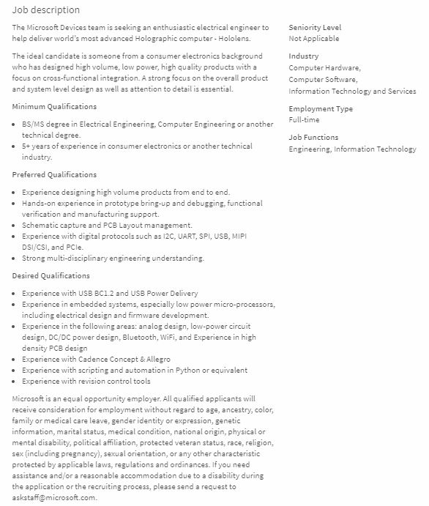


Slide 20
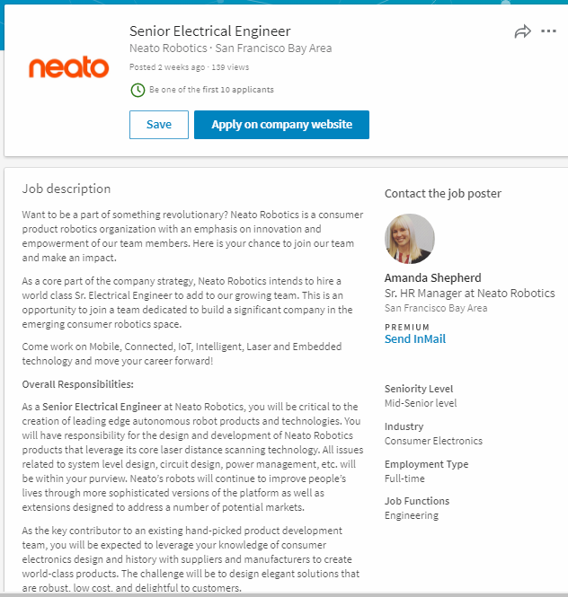

Slide 21
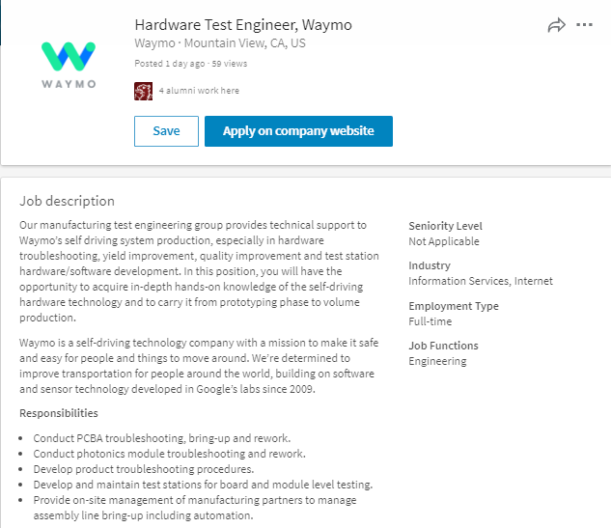

Slide 22
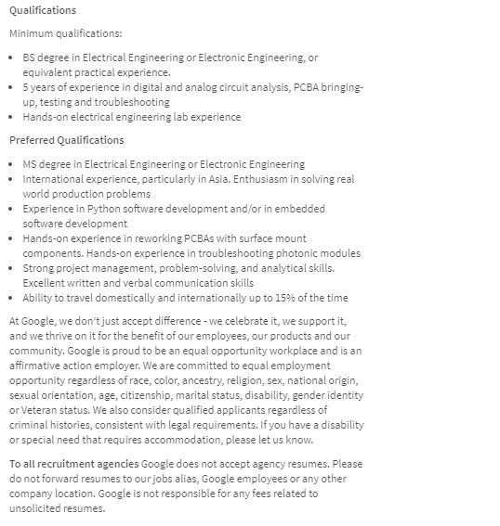

Slide 23
Material Ethics

Slide 24
In Class Discussion to Be Continued This Week
Focal Products
Research Examples of Focal Products
Candidates will be discussed in class and put forth in class discussion

Slide 25
Agenda
Focal Engineering is Local
Consequentialism
Assessing the Product
Consensus Conference Model
Conclusions

Slide 26
Material Ethics Seeks to Assess “Focalness” of an Endeavor
User
Engagement
Enlivenment
Product
World
Resonance

Slide 27
Conclusions
Material Ethics
Reflection and Assessment should precede “unleashing a new technology on the planet”
Discussion of the AIMS of the project brings modern engineers face-to-face with Focal engineering
Focal engineering acts locally to foster engagement, enightenment, and resonance
“Best Practices” for Focal Engineering may be to keep disengaging products away
Material Ethics assessment is based on relating engagement, enlightenment, and resonance to the product/user/world
Informed consensus approach key to achieving Material Ethics since it provides necessary inclusion

Slide 28
10 Technologies That Deserve to Die?
1. Nuclear Weapons
2. Coal- Based Power
3. The Internal Combustion Engine
4. Incandescent Light Bulbs
5. Land Mines
6. Manned Spacecraft
7. Prisons
8. Cosmetic Implants
9. Lie Detectors
10. DVDs
Define the Technologies
Ethically, do They Deserve to Die? How would you score the Materials Ethics of the identified technology?

Slide 29
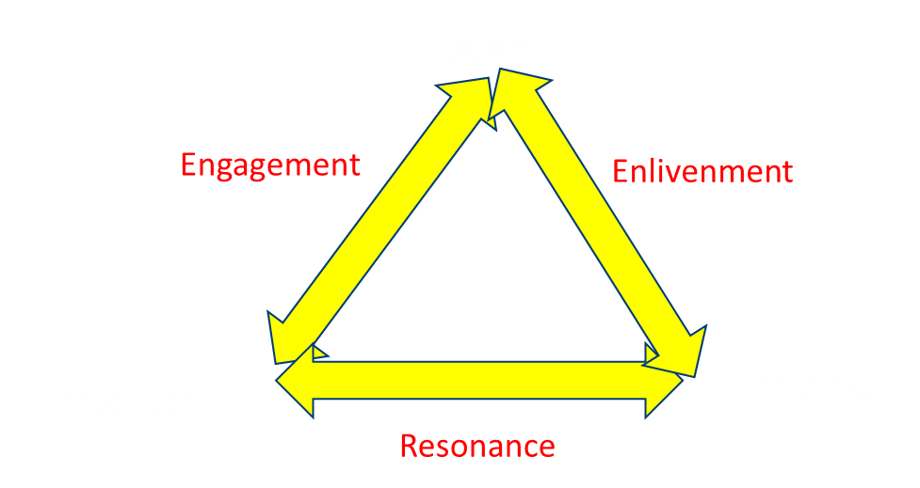
Assessing (New) Coal-Based Power
Engagement: End User and Product interaction→ (+3 to -3)
Enlivenment: End User and World (based on use of product)→ (+3 to -3)
Resonance: Product and World Interaction→ (+3 to -3)
Jm= a1(Jeg) +a2(Jen) +a3(Jre), where a1+a2+a3=1.0

Slide 30
Conclusions
Balance
Three kinds of ethics for three types of engineers
Premodern engineer > Virtue Ethics : Objectivity, Honesty and Caring
Modern engineer> Process Ethics
Focal Engineer > Material Ethics guides products
Premodern Engineering
Engineering endeavor, Engineer, Engineered bound up and contextualized
Think of the major cathedrals
Modern Engineering
Shift to colonization where function rules and hypermodernism arises
Consider Semiconductors and the derivative product proliferation
Focal Engineering
Balance Contextualism and Colonization
Seek the Good resulting in products that enliven, engage and resonate

Slide 31

MATERIAL ETHICS/ “Focalness” of Product
PRODUCT
RESONANCE
ENGAGEMENT
ENLIVENMENT
END-USER
WORLD

Slide 32
10 Emerging Technologies
1. Comparative Interactomics:
2. Nanomedicine
3. Epigenetics
4. Cognitive Radio
5. Nuclear Reprogramming
6. Diffusion Tensor Imaging
7. Universal Authentication
8. Nanobiomechanics
9. Pervasive Wireless
10. Stretchable Silicon
GROUPS TO PREPARE WRITTEN RESPONSES with group names on submission
What is the Technology? Concise description for the audience
What are some predictable applications? How can the tech be used?
B. Do you foresee any moral dilemma's with this technology? Safe and useful
C. Can it be focal or contribute to a focal product? How do you rate the “focalness”?

Slide 33
Cognitive Radio
-Radio that can be programmed and configured dynamically to use the best wireless channels in its vicinity to avoid user interference and congestion.
-Allows open radio channels or “white space” to be utilized if not currently taken

Slide 34
Universal Authentication
Universal authentication is a method for verifying the identity of users and computers on a network without asking for the same identification every time the user moves from site to site. The idea is that a security platform works out all the authentication requirements for all subsequent access to nodes within the same security area so that the user does not have to input his/her security credentials again every time a new node is encountered.

Slide 35
Pervasive Wireless
The ability to form ad hoc networks forms the basis of pervasive computing–in which everything from your car to your coffee cup “talks” to other devices in an attempt to make your life run more smoothly.

Slide 36
Stretchable Silicon
Flexible circuits are made of organic semiconductors sprayed or stamped onto plastic sheets. Although useful for roll-up displays, organic semiconductors are just too slow for more intense computing tasks. For those jobs, you still need silicon or another high-speed inorganic semiconductor

